Slide 1
City of Uniontown HEC-RAS
Flood Study
Prepared for Redevelopment Authority City of Uniontown

Slide 2
What is HEC-RAS
The acronym stands for Hydraulic Engineering Center – River Analysis System
HEC-RAS Version 5.0.7 was released March 2019 by the USACOE
HEC-RAS offers both One-Dimensional and Two-Dimensional analysis
For the Uniontown Flood Study a One-Dimensional Analysis is used.
A Two-Dimensional Analysis can be made available.

Slide 3
What is HEC-RAS used for ?
Management of Navigable Rivers and Harbors
Design and Investigation of Dams, Reservoirs and Levees
Study and Development of Flood Insurance Maps
Evaluation of Floodplain Encroachments
Investigation of Channel Modifications
Sediment Transport and Run-Off studies
Emergency Action Planning
Municipal Planning & Development Studies
Many other Engineering Uses

Slide 4
How does HEC-RAS work?
Solution of One-Dimensional Energy Equation for steady flow
Energy Losses computed by friction and contraction / expansion
Momentum equation used for rapidly varying water surface profiles
Analysis includes hydraulic jumps, hydraulics of culverts and bridges, and evaluation of river confluences, such as Coal Lick Run and Redstone Creek.

Slide 5
How is the Model developed?
Obtaining Digital Terrain Data
Obtained from PASDA (Pennsylvania Spatial Data Access)
www.pasda.psu.edu
Delineating the river reach(s)
Coal Lick Run and Redstone Creek
Obtaining Flow Data
PA StreamStats
Verification of Digital Terrain elevations / profiles / cross sections
Field Investigation

Slide 6
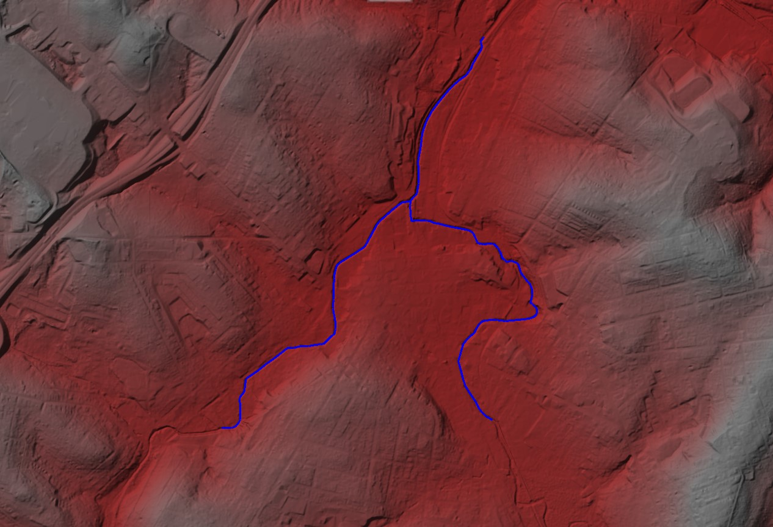
Digital Terrain Model
Image of Base Digital Terrain showing the study limits of Coal Lick Run and Redstone Creek.

Slide 7
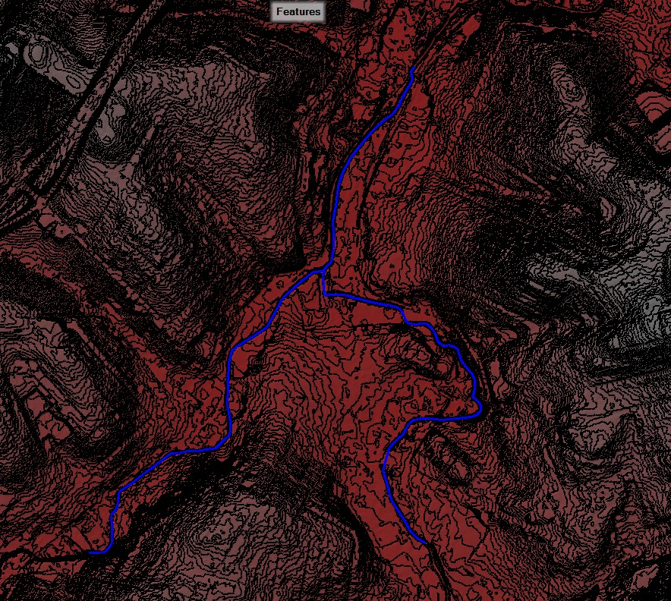
Digital Terrain with Contours Added
Files are geo-referenced and overlay onto the Digital Terrain Model

Slide 8
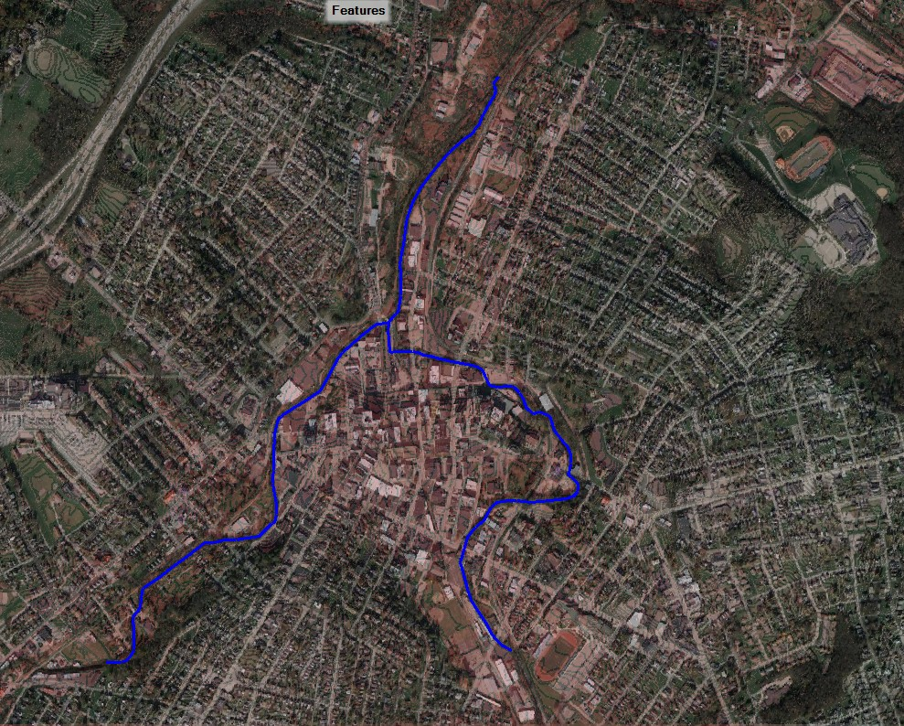
Satellite Imagery Overlaid onto Terrain Model
Google maps or other “geo-referenced” imagery can be added to the model. This includes specialized mapping available from various sources, such as ground cover, wetlands, agriculture, land use, etc.

Slide 9
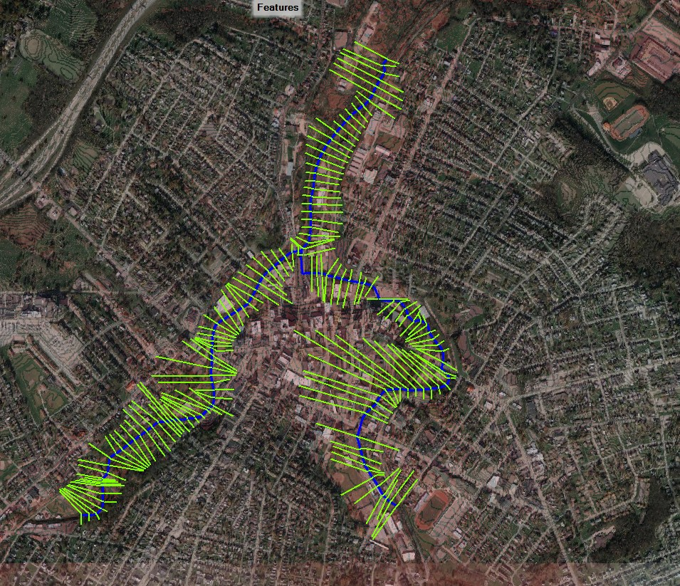
Cross Sections added to the Model
Elevation data is extract from the Digital Terrain Model and used to define the floodplain and river profiles.
There are limitations associated with the Digital Terrain Model

Slide 10
LIDAR is the acronym for LIght Detection And Ranging", or for "Laser Imaging, Detection and Ranging
One of its limitations is that it does not “see” below the water surface. As a result, elevation data within the channel may not be a true representation of the physical conditions.
In many cases it is sufficient to use the “raw” data and remain within the statistical accuracy of a HEC-RAS model.
For our study, field survey of the channel was performed and transposed into the digital model.

Slide 11
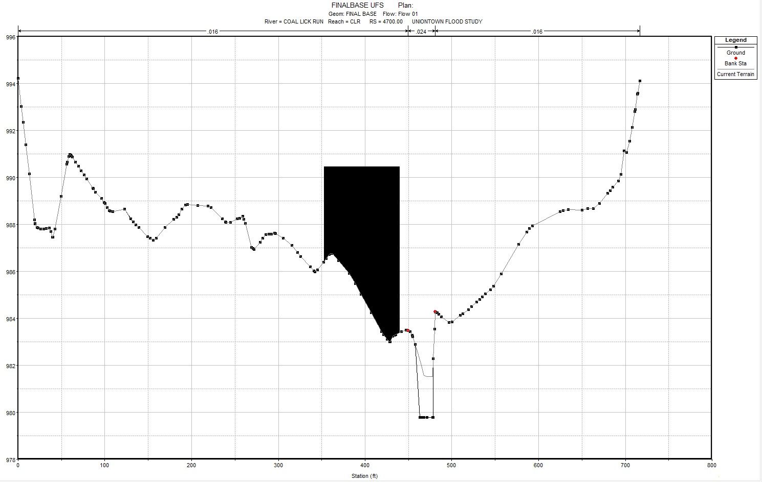
General Cross Section modified with Field Survey
Elevation points within the floodplain are unchanged however, the channel width and depth are adjusted to reflect field survey data. Note Blocked Out Area is an “Obstruction” manually entered into the cross section data.

Slide 12
Existing Bridges / Culverts and Buildings
To complete the model:
Field Survey of Bridge Decks and Hydraulic Openings
Determination of Manning's N- Values for floodplain cover
Adding in the “little details” to reflect real world conditions

Slide 13
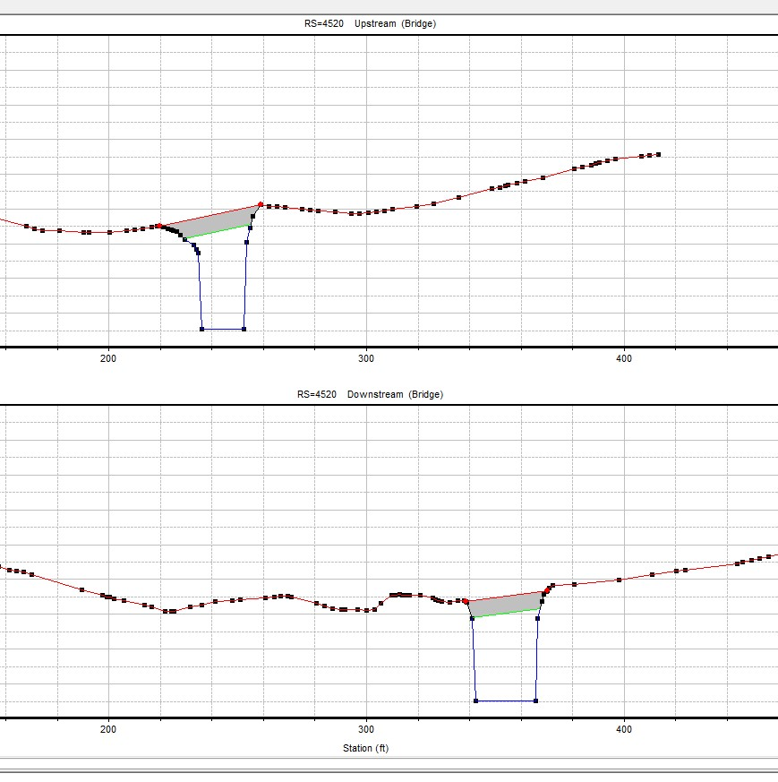
Typical Section Upstream and Downstream of a bridge
Using Field Survey Data, the various bridges alone Coal Lick Run and Redstone Creek are entered into the model.

Slide 14
OBTAINING Flow Data
Flow data for this study was obtained from PA StreamStats – a DEP approved source.
Flow Data was also reviewed from existing FEMA Flood mapping for comparison.

Slide 15
PA Streamstats flow data
Flow data for this study included:
2-Year Reoccurrence Interval
5-Year Reoccurrence Interval
10-Year Reoccurrence Interval
50-Year Reoccurrence Interval
100-Year Reoccurrence Interval
500-Year Reoccurrence Interval
Bank-Full Flow / Average Normal Flow

Slide 16
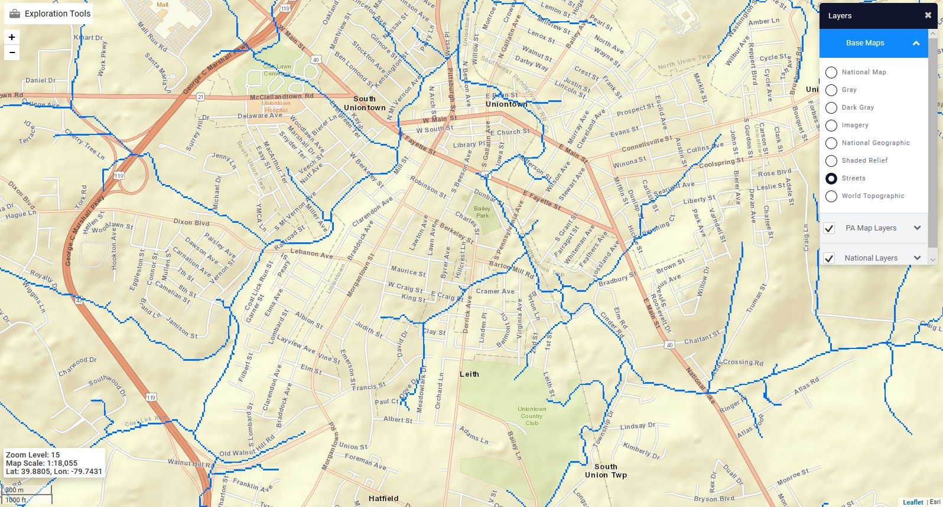
Streamstats mapping of streams contributary to study area

Slide 17
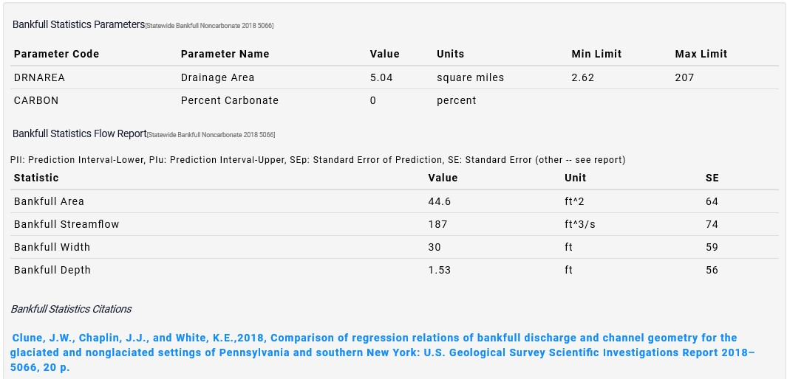
Sample of PA Streamstats data

Slide 18
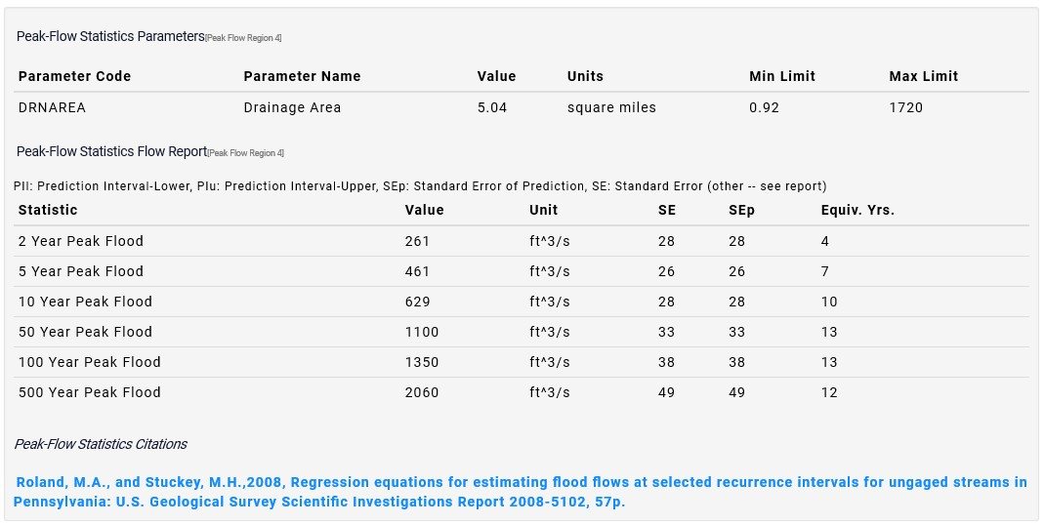
Sample of Pa StreamStats data

Slide 19
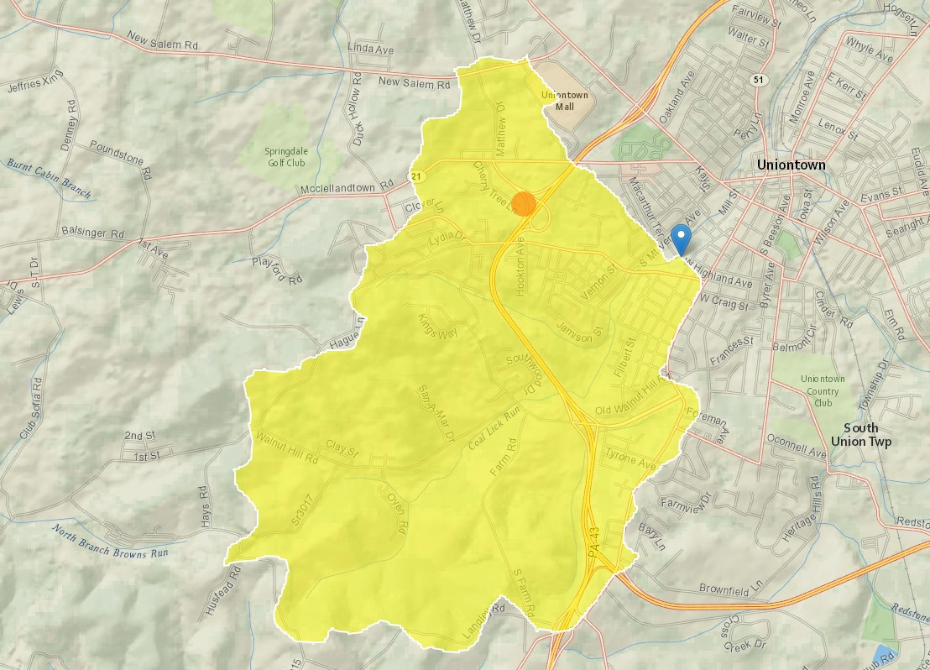
Contributary watershed for upper coal lick run section

Slide 20
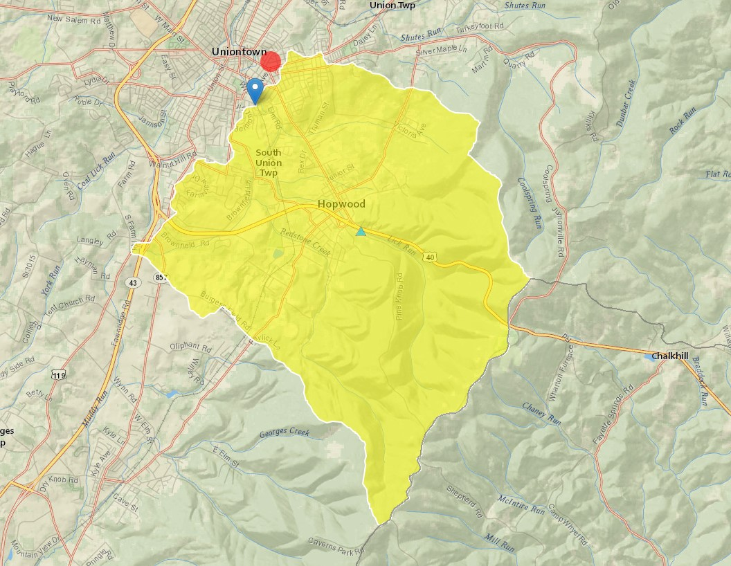
Redstone Creek Watershed

Slide 21
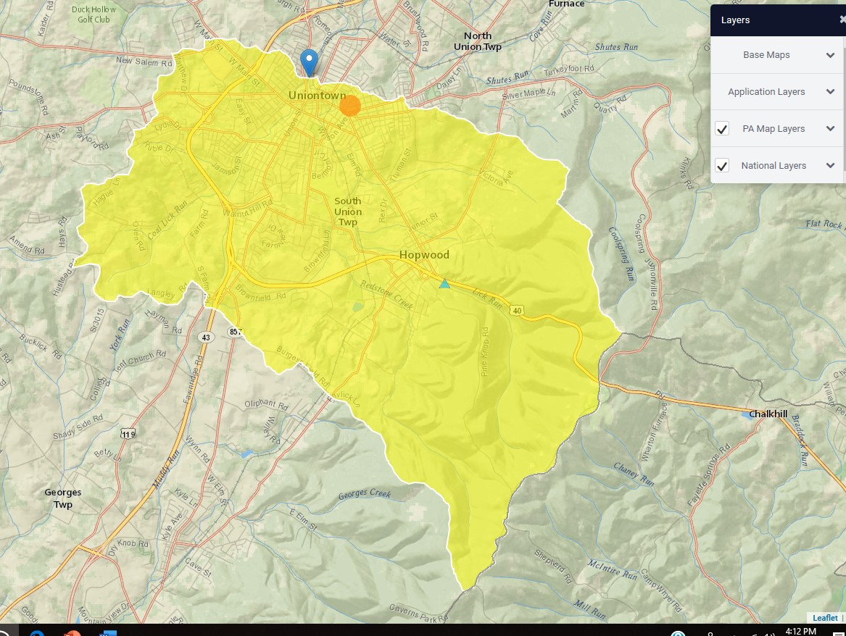
Combined Watersheds

Slide 22
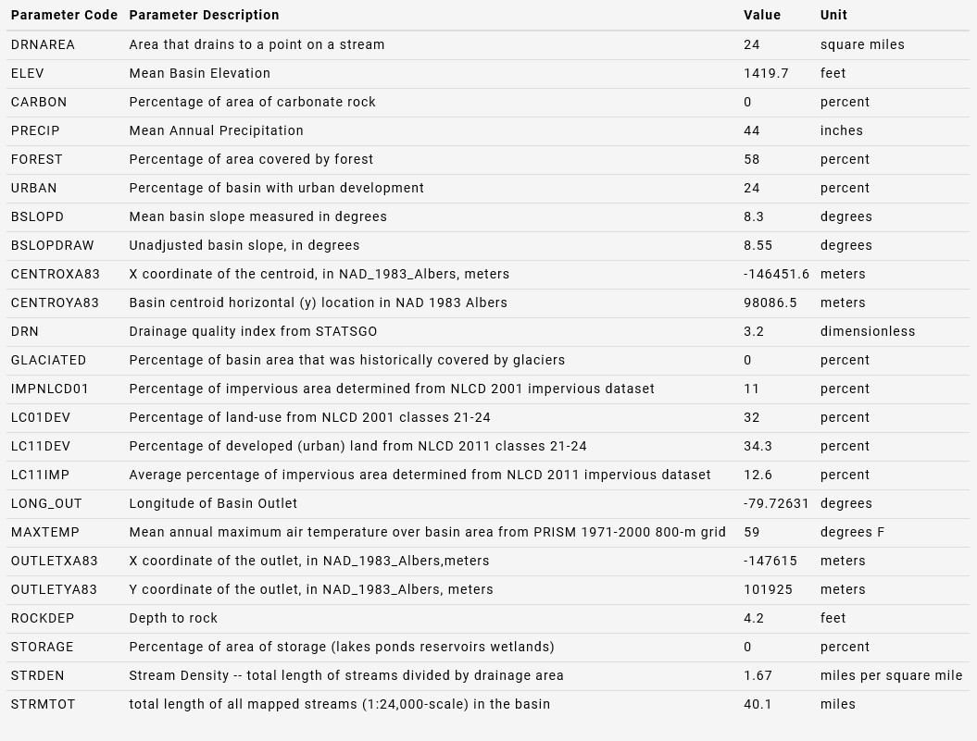
Basin statistics

Slide 23
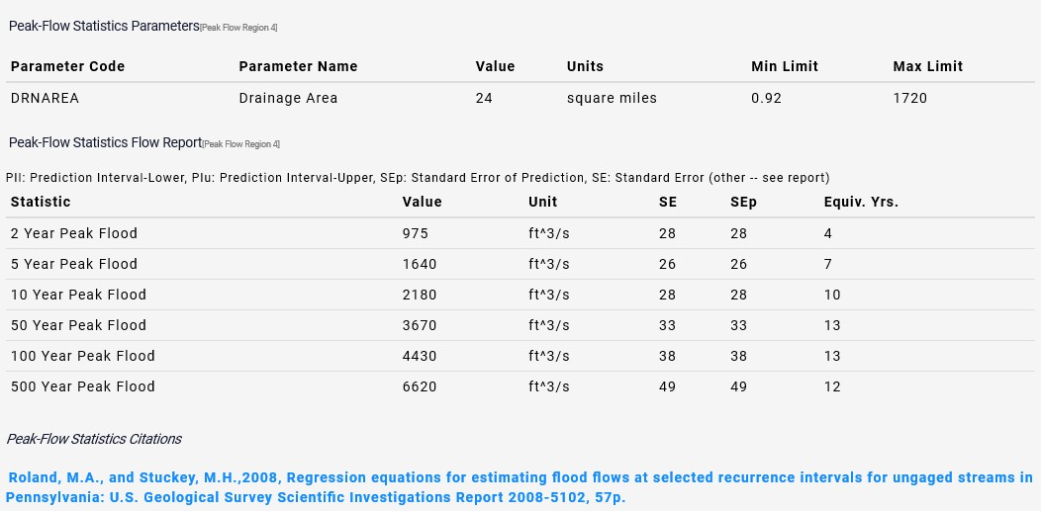
Net Flow at Junction
Coal Lick & Redstone

Slide 24
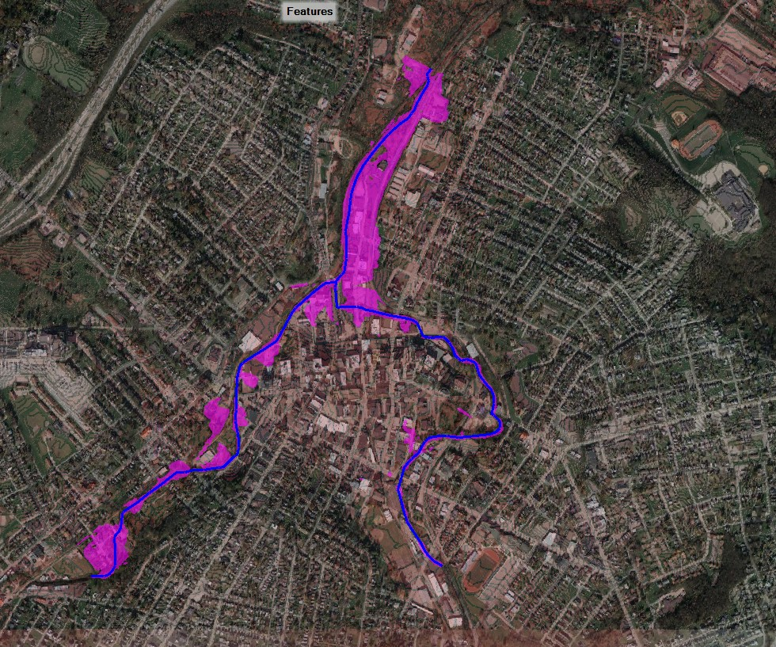
Preliminary Results mapping
100-year floodplain

Slide 25
Things to consider !!
Changes have both positive and negative results!
Mitigation may be required “outside” the City of Uniontown boundaries!
Changes can result in adverse conditions both downstream and upstream (sediment transport, erosion, scour, flooding, etc.)
A regional Approach is the best approach. Coordination is mandatory to avoid litigation as a result of changes / modifications to existing conditions.
No model is perfect – but a good model is necessary
Maintenance is a necessary “never ending story”.

Slide 26
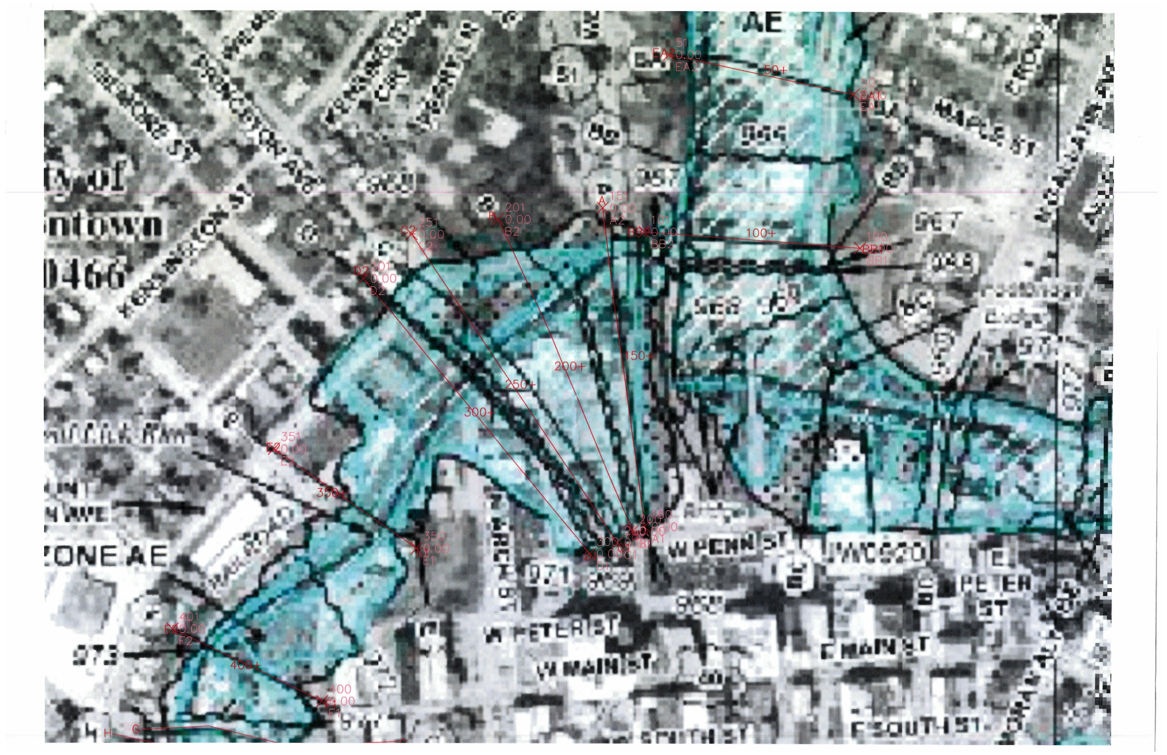
The next steps
Individual section studies
Review of obstructions
Development of mitigation measures
Planning & Programming

Slide 27
QUESTIONS

